Slide 1

Presentation Materials Created by Mimetics Inc.
Free use by anyone for non-commercial purposes
Copyrights, Trademarks and other Registered Marks the Property of their Owners

Slide 2
Grade 6 – Class 10 – Challenge Continued
Notes:
We want to introduce the Jade Robot and it’s Tools in more detail along with our action plans for it.
It’s interesting, but it’s easy to criticize something when it’s done (especially when you have experience) – a *LOT* more difficult getting it right from the start. Also, preparing this presentation was a great way to review and think about what we should be doing.

Slide 3
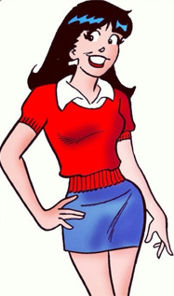
Recap
What are the Steps for Creating a Program?
What is the Robot Program Structure?
What do you do when things go wrong?
What Does Good Documentation Have?
Notes:
Can Demo Jade Scratch if people are interested. In doing this product I’ve had a few interesting discoveries – one was going with a simpler programming language actually has a *LOT* of value for an expert like myself.

Slide 4
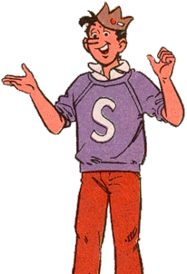
Creating a Program
Get Requirements
Break Requirements into Parts
For Each Part, List Statement Types
Create a Sequence of Statements
Test Statements for Each Part
Work in Sequence and Build Up Program as Sum of Parts
Test Final Program to Requirements
Celebrate!!!
Notes:
Can Demo Jade Scratch if people are interested. In doing this product I’ve had a few interesting discoveries – one was going with a simpler programming language actually has a *LOT* of value for an expert like myself.

Slide 5
Recap
What are the Steps for Creating a Program?
What is the Robot Program Structure?
What do you do when things go wrong?
What Does Good Documentation Have?
Notes:
Can Demo Jade Scratch if people are interested. In doing this product I’ve had a few interesting discoveries – one was going with a simpler programming language actually has a *LOT* of value for an expert like myself.

Slide 6
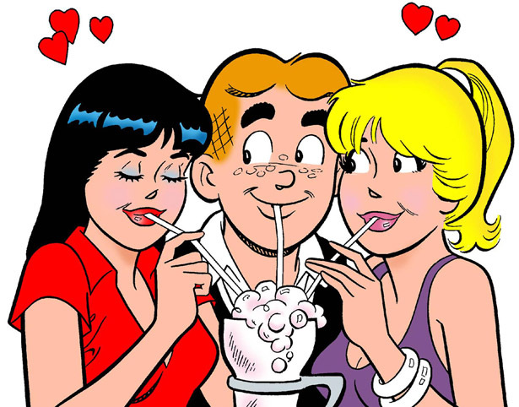
Robot Program Structure
Initialize Robot
Get Input
Process
Repeat (Loop)
Output Processed Inputs
Shutdown Robot
(Stop)
Notes:
Can Demo Jade Scratch if people are interested. In doing this product I’ve had a few interesting discoveries – one was going with a simpler programming language actually has a *LOT* of value for an expert like myself.

Slide 7
Recap
What are the Steps for Creating a Program?
What is the Robot Program Structure?
What do you do when things go wrong?
What Does Good Documentation Have?
Notes:
Can Demo Jade Scratch if people are interested. In doing this product I’ve had a few interesting discoveries – one was going with a simpler programming language actually has a *LOT* of value for an expert like myself.

Slide 8
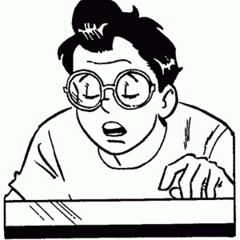
Steps to Solve a Problem
Check Spelling/Statements
Single Step through the Program
Add Display Updates and LED Outputs to Track Progress
Isolate small Parts of the Program and Test Operation
Notes:
Can Demo Jade Scratch if people are interested. In doing this product I’ve had a few interesting discoveries – one was going with a simpler programming language actually has a *LOT* of value for an expert like myself.

Slide 9
Recap
What are the Steps for Creating a Program?
What is the Robot Program Structure?
What do you do when things go wrong?
What Does Good Documentation Have?
Notes:
Can Demo Jade Scratch if people are interested. In doing this product I’ve had a few interesting discoveries – one was going with a simpler programming language actually has a *LOT* of value for an expert like myself.

Slide 10
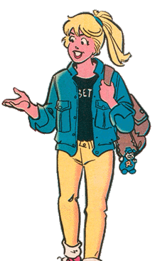
Good Documentation has:
PICTURES!!!
Program Requirements
Overall Program Description
Breakout of Program Parts
List (with Description) of:
Inputs & Outputs
Variables
Subroutines & Functions (if used)
Notes:
Can Demo Jade Scratch if people are interested. In doing this product I’ve had a few interesting discoveries – one was going with a simpler programming language actually has a *LOT* of value for an expert like myself.

Slide 11
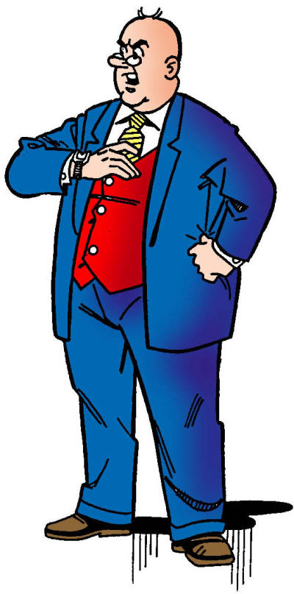
Draw a Square Reducing Spiral. The first side is 45cm long. Decreasing by 2cm after each side. Stop when side length equals 5cm
Notes:
We want to introduce the Jade Robot and it’s Tools in more detail along with our action plans for it.
It’s interesting, but it’s easy to criticize something when it’s done (especially when you have experience) – a *LOT* more difficult getting it right from the start. Also, preparing this presentation was a great way to review and think about what we should be doing.

Slide 12
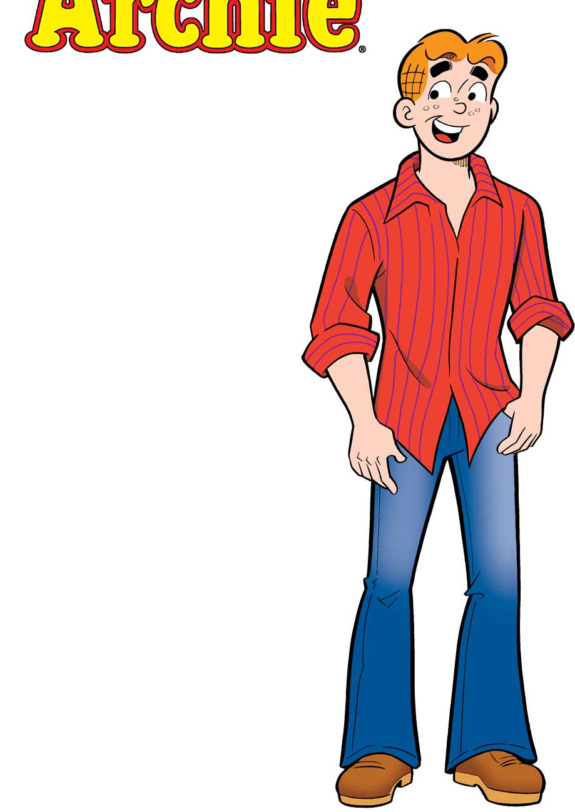
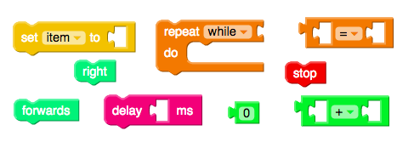
Draw a Square Reducing Spiral.
The first side is 45cm long.
Decrease by 2cm after each side.
Stop when side length equals 5cm.
Notes:
We want to introduce the Jade Robot and it’s Tools in more detail along with our action plans for it.
It’s interesting, but it’s easy to criticize something when it’s done (especially when you have experience) – a *LOT* more difficult getting it right from the start. Also, preparing this presentation was a great way to review and think about what we should be doing.

Slide 13
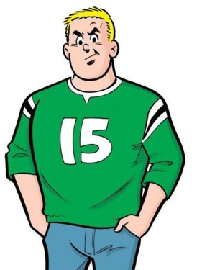
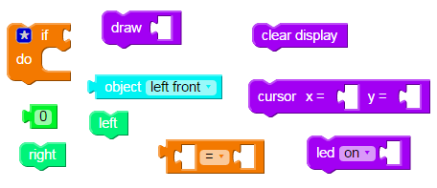
When you’re done:
Add Object Detection & Avoidance:
Notes:
We want to introduce the Jade Robot and it’s Tools in more detail along with our action plans for it.
It’s interesting, but it’s easy to criticize something when it’s done (especially when you have experience) – a *LOT* more difficult getting it right from the start. Also, preparing this presentation was a great way to review and think about what we should be doing.

Slide 14
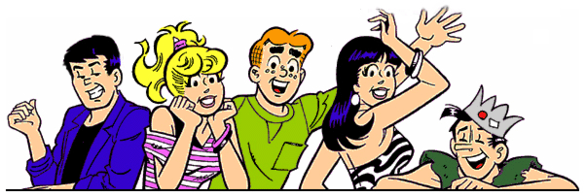
For Next Week
Document Your Programs
Think about what you would like me to do
Notes:
We want to introduce the Jade Robot and it’s Tools in more detail along with our action plans for it.
It’s interesting, but it’s easy to criticize something when it’s done (especially when you have experience) – a *LOT* more difficult getting it right from the start. Also, preparing this presentation was a great way to review and think about what we should be doing.

